Slide 1

EDA Capstone Project
Abhranil Dey

Slide 2
Introduction
Understanding the dynamics of hotel bookings is crucial for optimizing pricing strategies, improving customer satisfaction, and maximizing occupancy rates. With the Hotel Booking Dataset, we have a rich source of information on various aspects of hotel reservations.
Leveraging this data, we aim to answer several critical questions for hotel management such as:
when the best time of year to book a hotel room is?
What is the optimal length of stay to get the best daily rate?
What if we wanted to predict whether a hotel was likely to receive a disproportionately high number of special requests?
By exploring and analyzing this dataset, we aim to uncover important factors that influence hotel bookings. The insights gained from this analysis will help hotel managers make informed decisions regarding pricing, marketing, and operational strategies to enhance overall business performance.

Slide 3
Features
This data has 119390 rows and 32 columns. Here are the columns
Hotel
Is_cancelled
Arrival_date_year
Arrival_date_month
Arrival_date_week_number
Day_of_the_month
Stays_in_weekend_nights
Stays_in_week_nights
Adults
Children
Babies
Meals
Country
Market_segment
Distribution Channel
Is_repeated_guest
Previous_cancellations
Previous_bookings_not_canceled
Reserved_room_type
Assigned_room_type
Booking_changes
Deposit_type
Agent
Lead_time
Days_in_waiting_list
Customer_type
Adr
Required_car_parking_spaces
Booking changes
Reservation_status
reservation_status_date

Slide 4
Data Wrangling
Data Cleaning:-
Removed outlier from the adr (average daily rate ) column
Dropped 31994 duplicate values from the dataset
Dropped Columns with Maximum Null values– agent and company
Deleted rows where total number of guests were 0
Replaced missing values in the country and children columns with ‘Others’ and 0 respectively
Columns with nominal null values have been filled with
Numerical column:- 0 (children)
String column:- Others (Country)
Data Manipulation:-
Combining columns for an effective study
total_stay_nights= Stays_in_weekend_nights+Stays_in_week_nights
Changed datatype of the column reservation_status_date from string to datetime

Slide 5
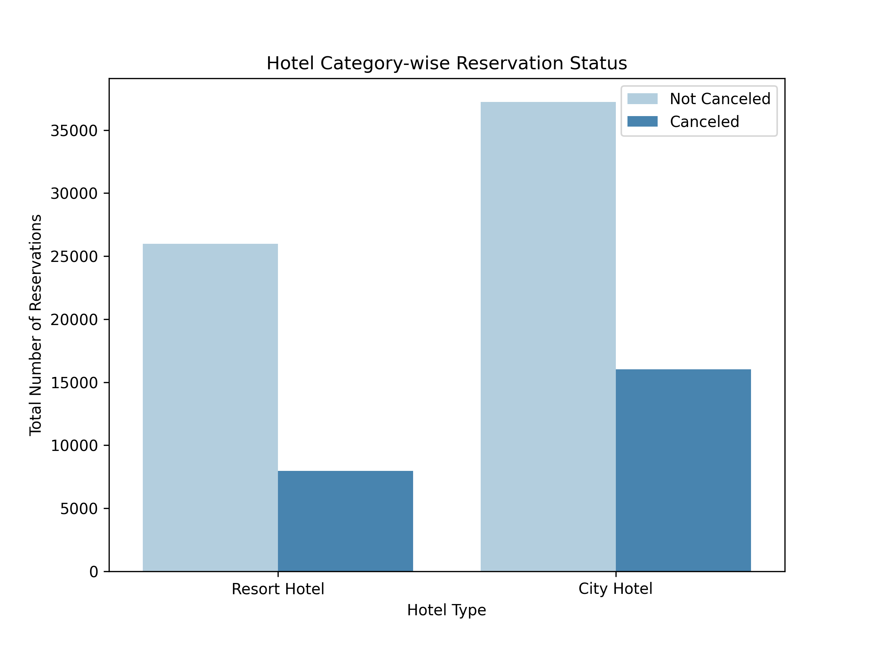
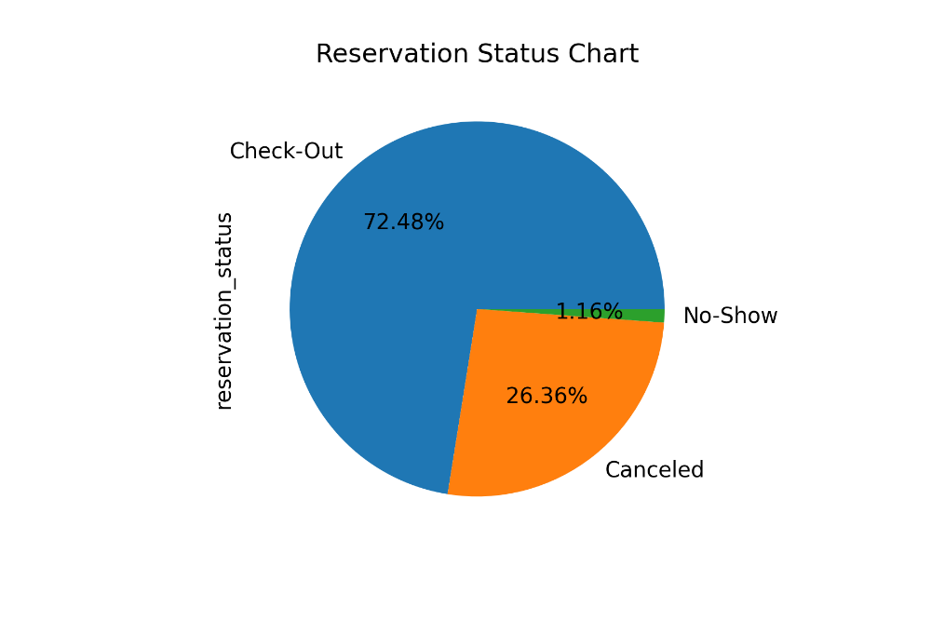
Reservation Status Analysis
Around 26.36% reservation got cancelled and 1.16% was no show as per the overall Reservation status chart
Total number of booking is higher in the City hotel and cancellation rate is also higher in the City hotel

Slide 6
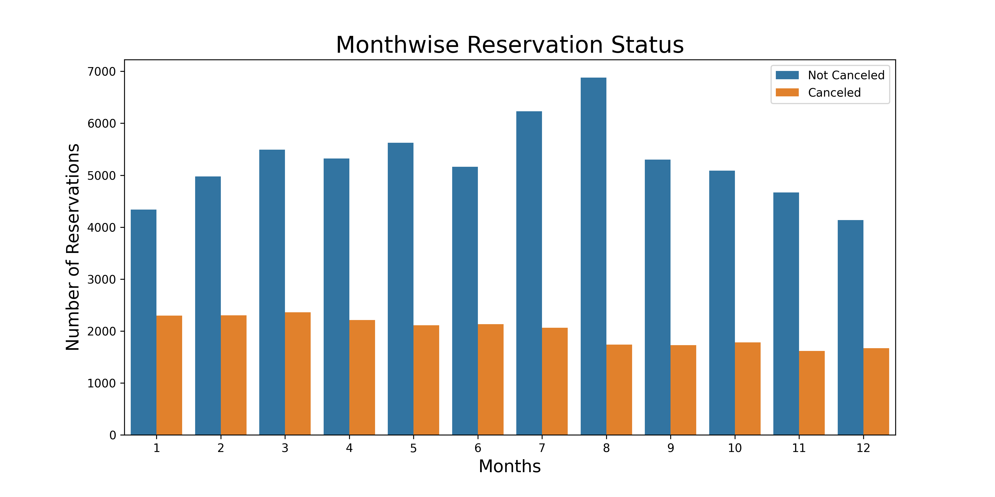
Comparative study of reservation in each month
Hotels receive a large number of bookings in the month of July and August as compared to others
On the other hand, a lot of bookings get cancelled during January, February and March

Slide 7
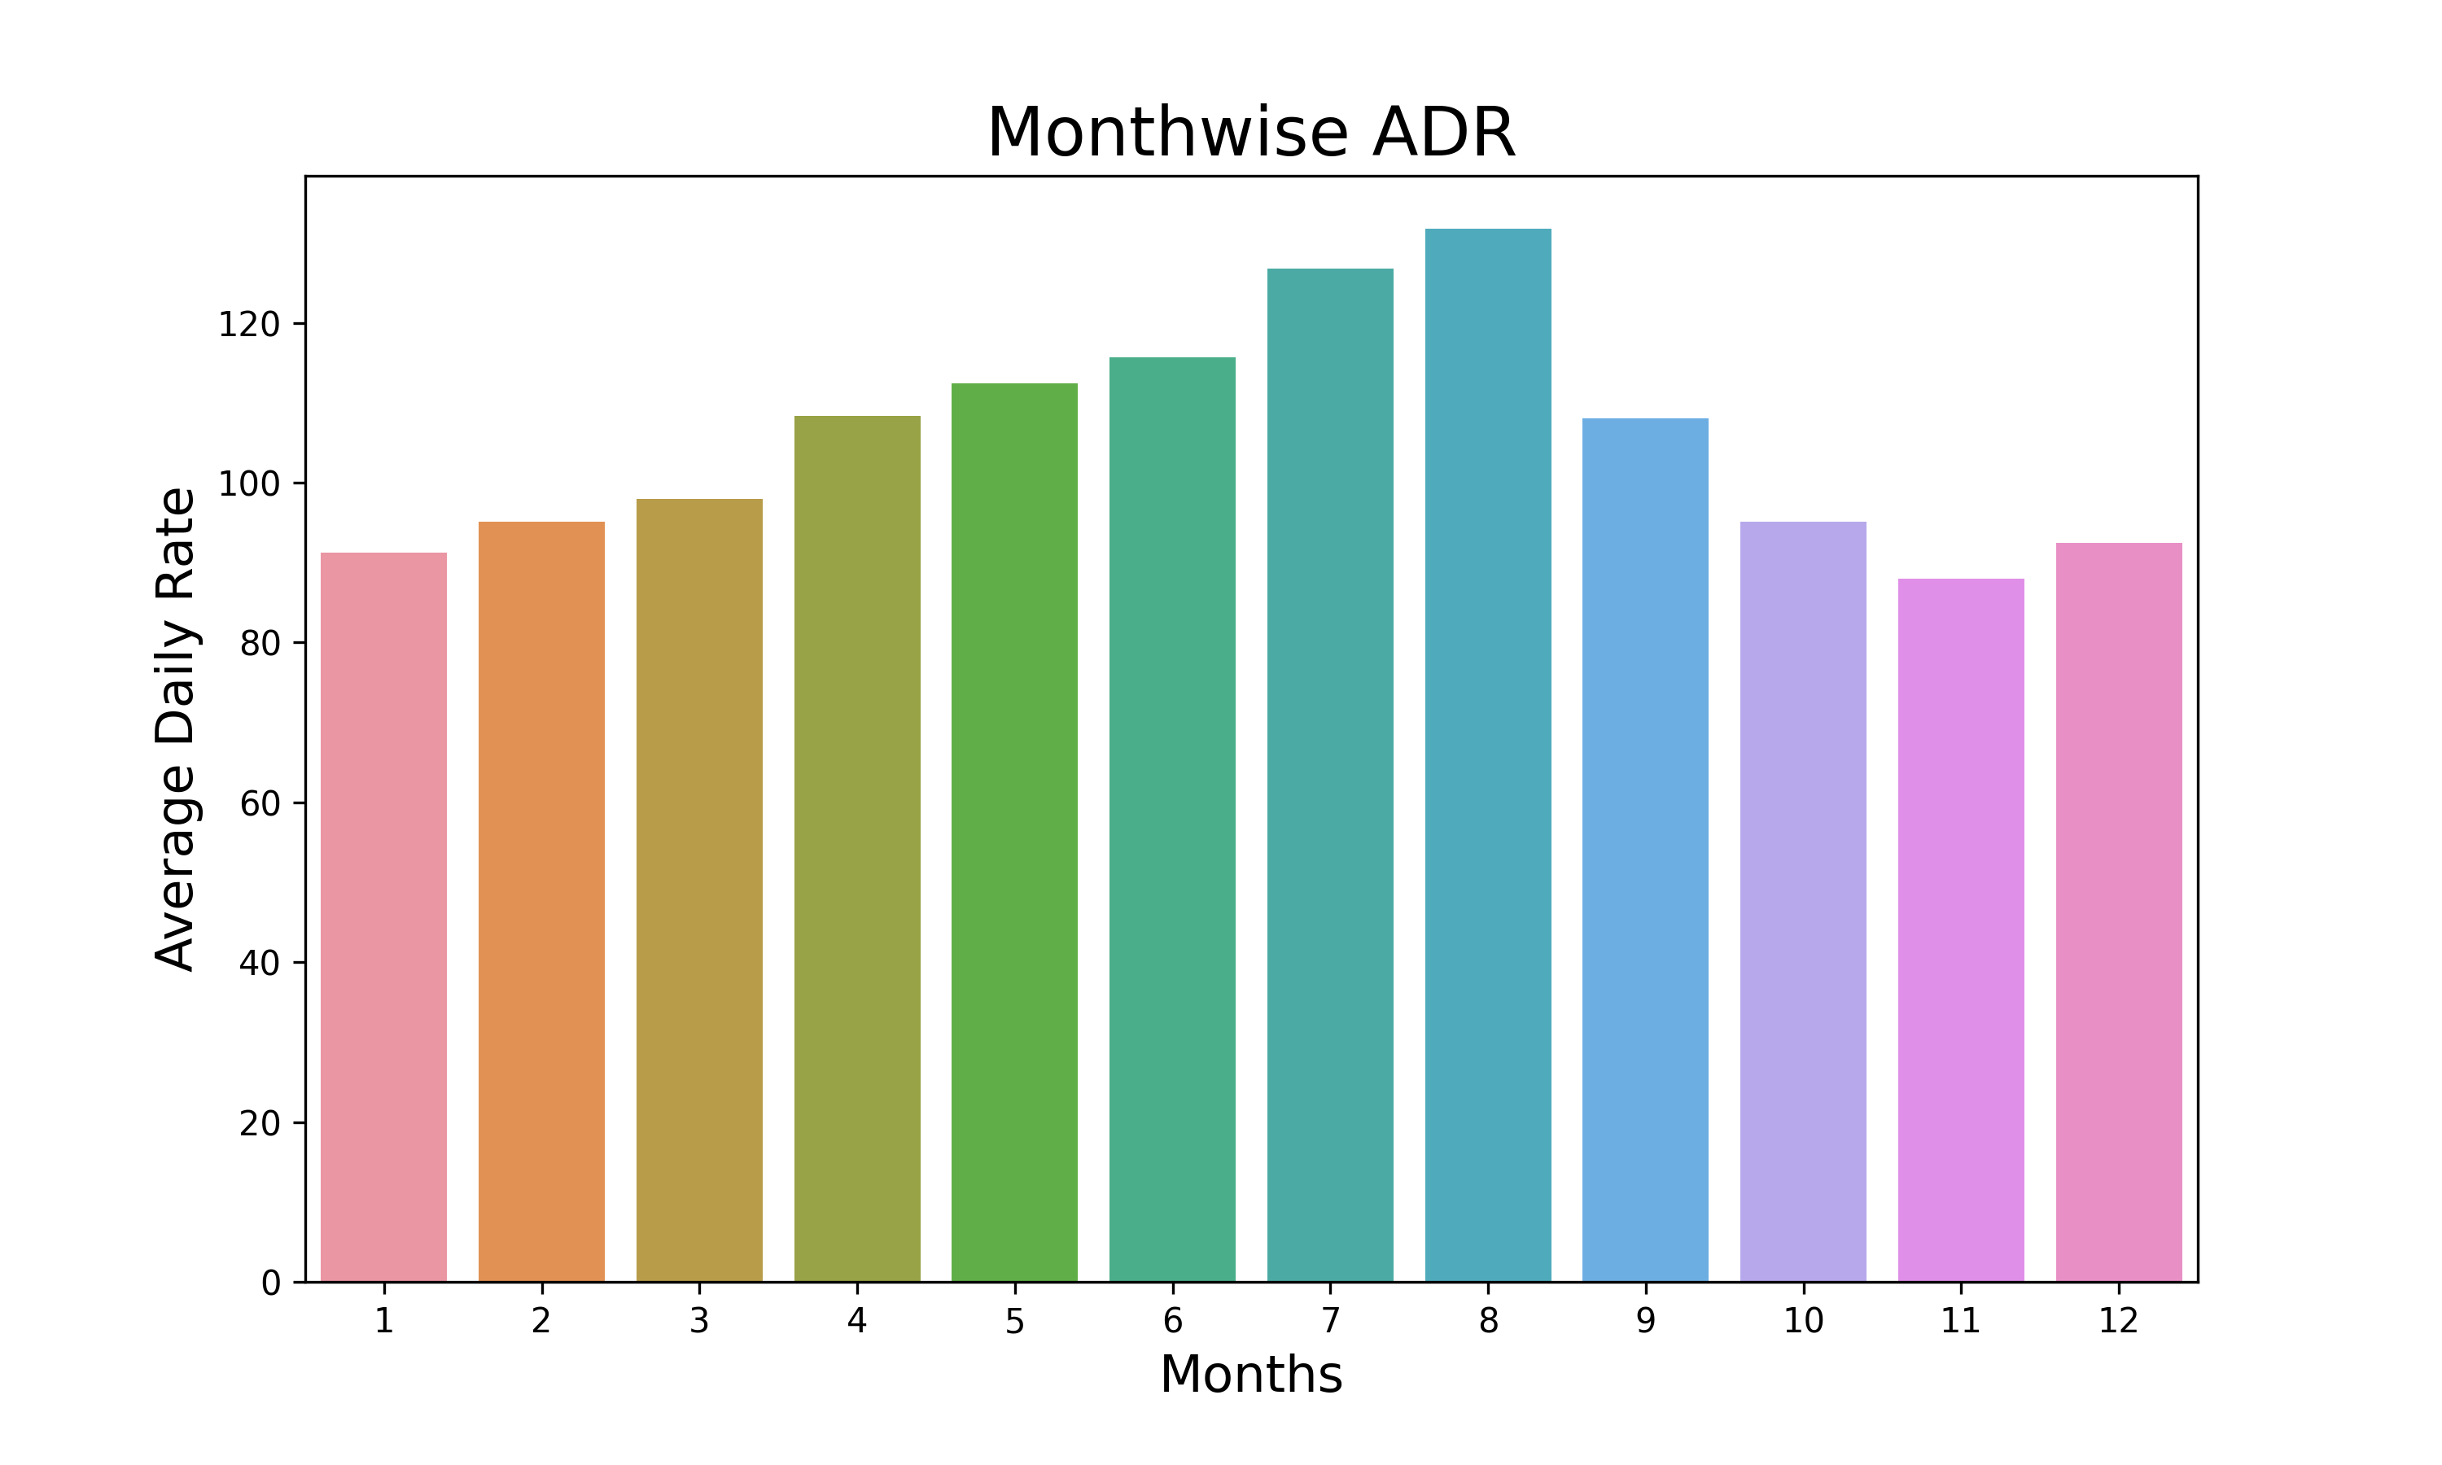
Monthly analysis of Average daily rate
Average daily rate is significantly higher in certain months like July and August, which indicates the peak demand periods. Low average daily rate in certain months indicate off-season.

Slide 8
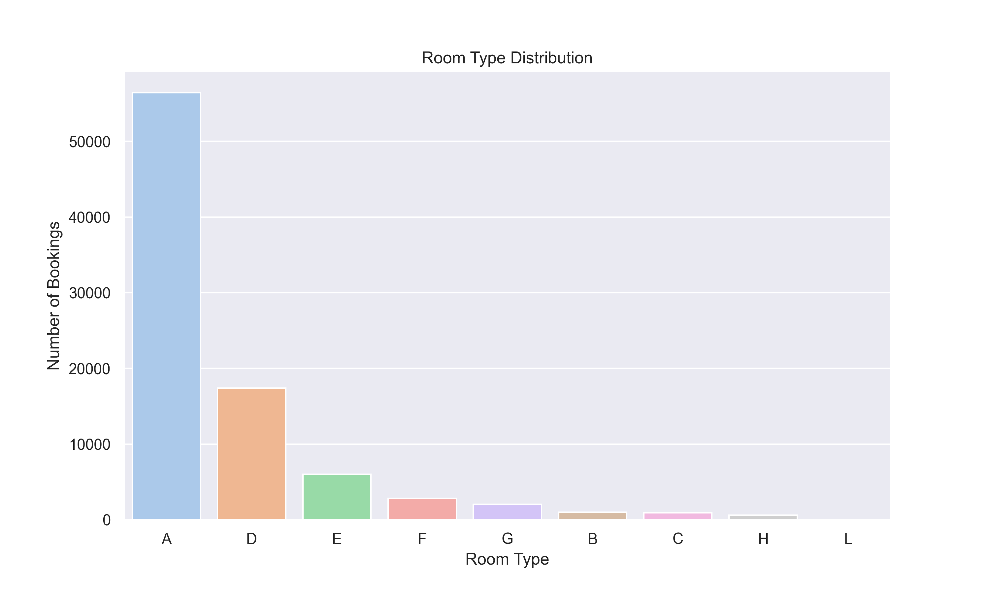
Preference of different room type
Majority of people prefer room type A. Room type H and L are least preferred among the customers

Slide 9
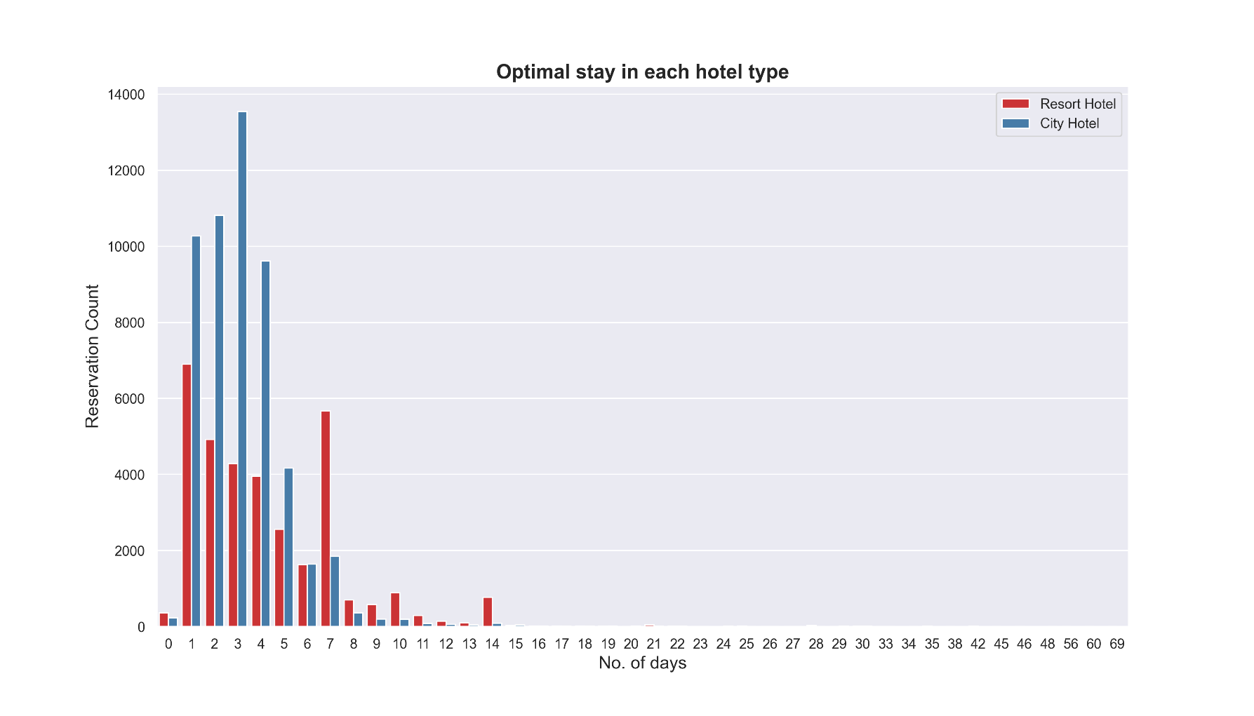
Preferred stay period
Generally, people prefer City hotel for shorter stays and Resort hotel for longer stays. Preferred stay in City hotel is between 1 to 4 days and 1 to 7 days in Resort hotel

Slide 10
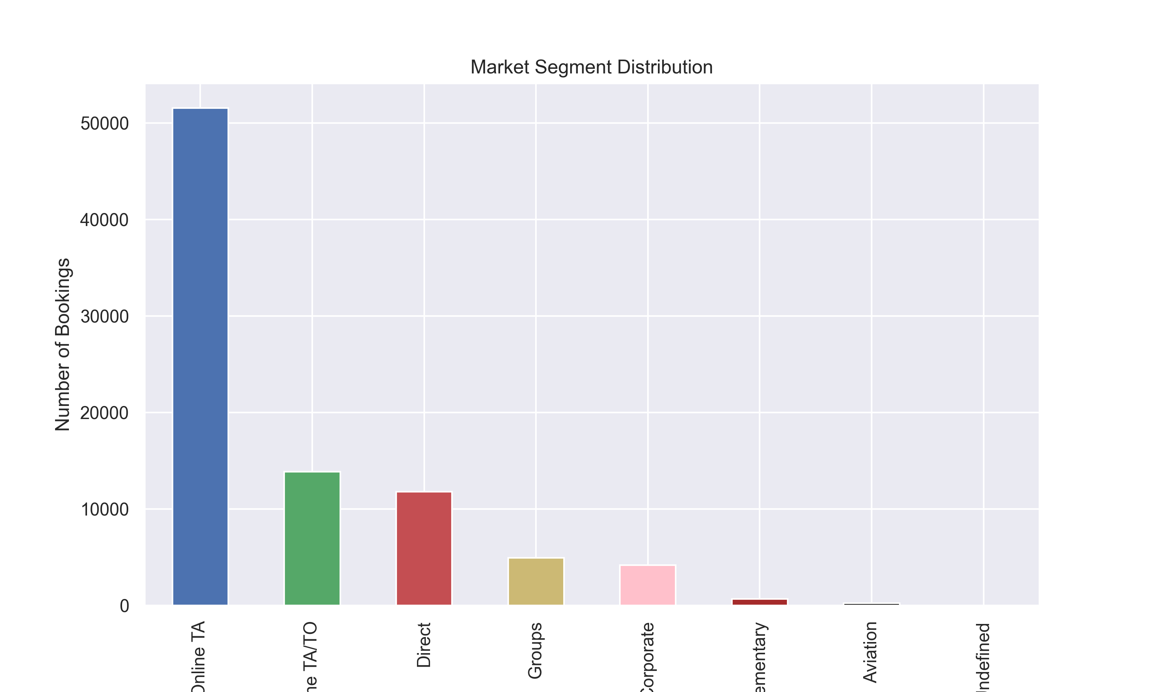
Analysis of Market Segments
Most guests prefer Online Travel Agents to book hotels

Slide 11
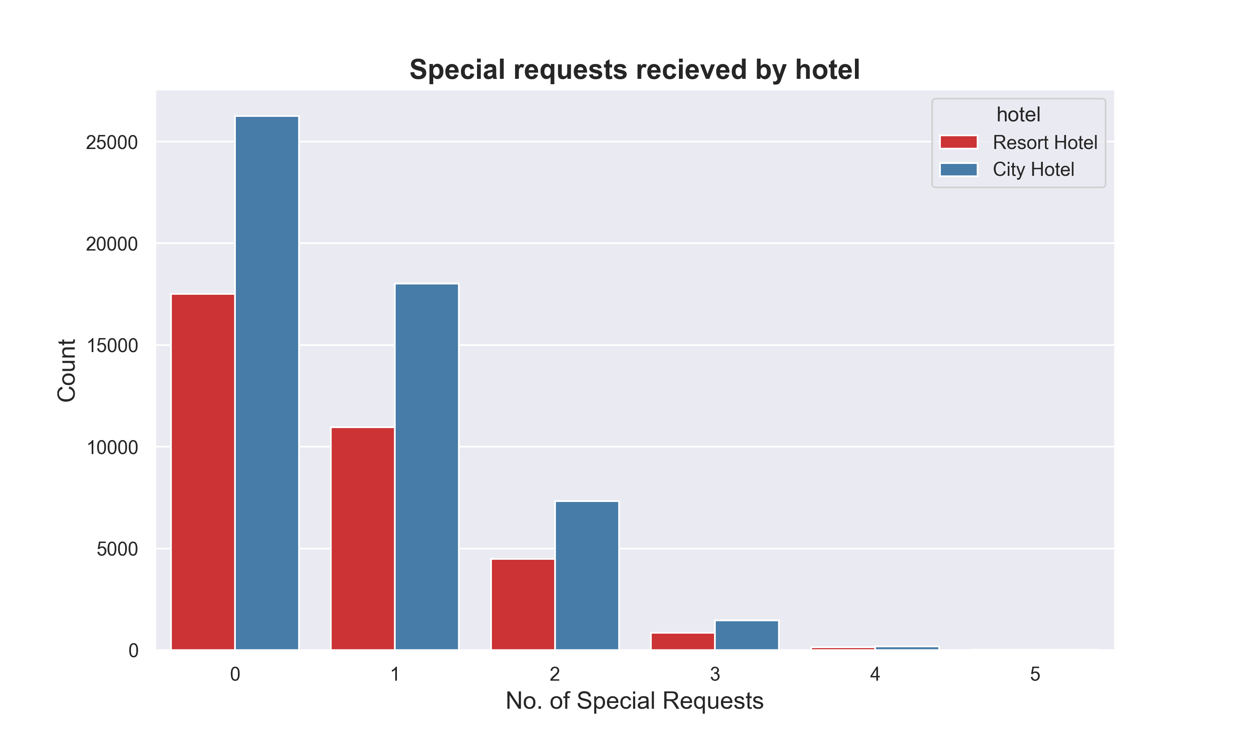
Analysis on special requests
City hotel receives more special requests than Resort hotel. Most of the customers don’t have special requests

Slide 12
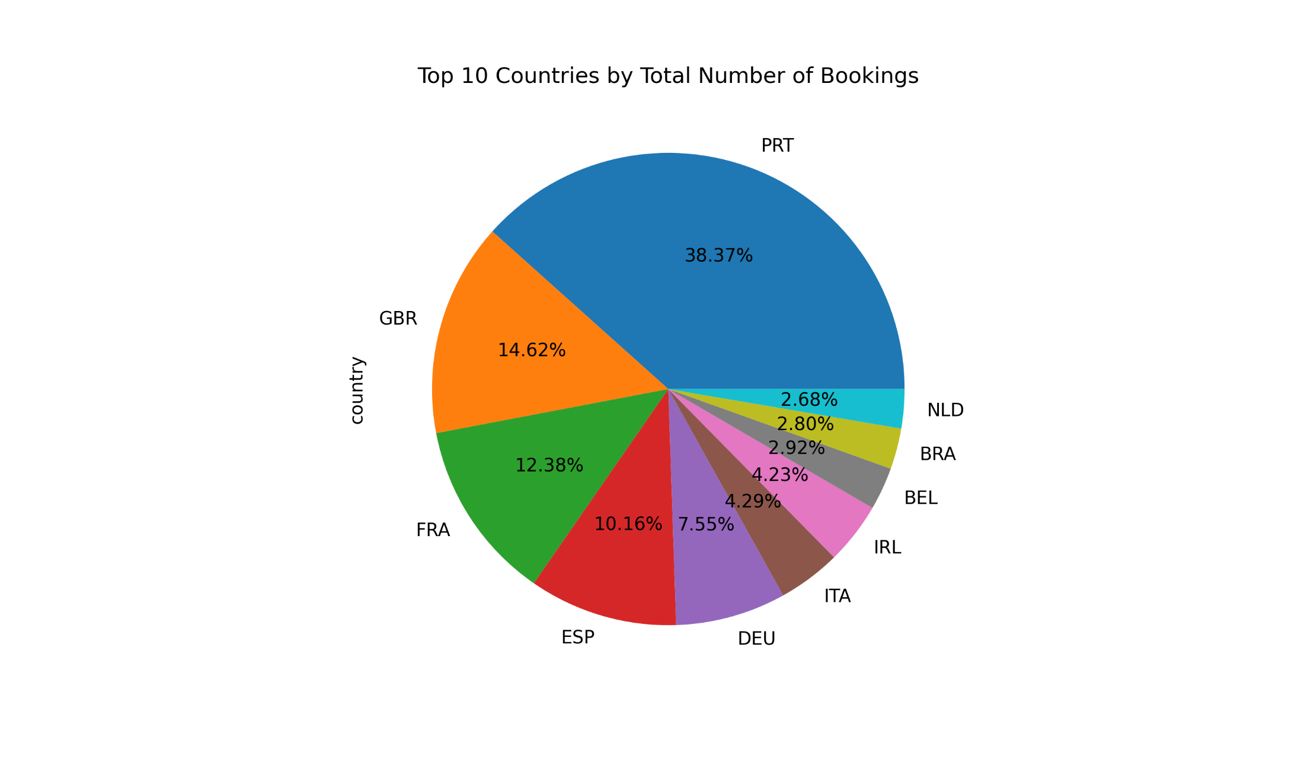
Analysis based on Country
Most of the guests come in from European countries like Portugal, Great Britain, France, Spain etc.
Around 39% of guests come in from Portugal alone

Slide 13
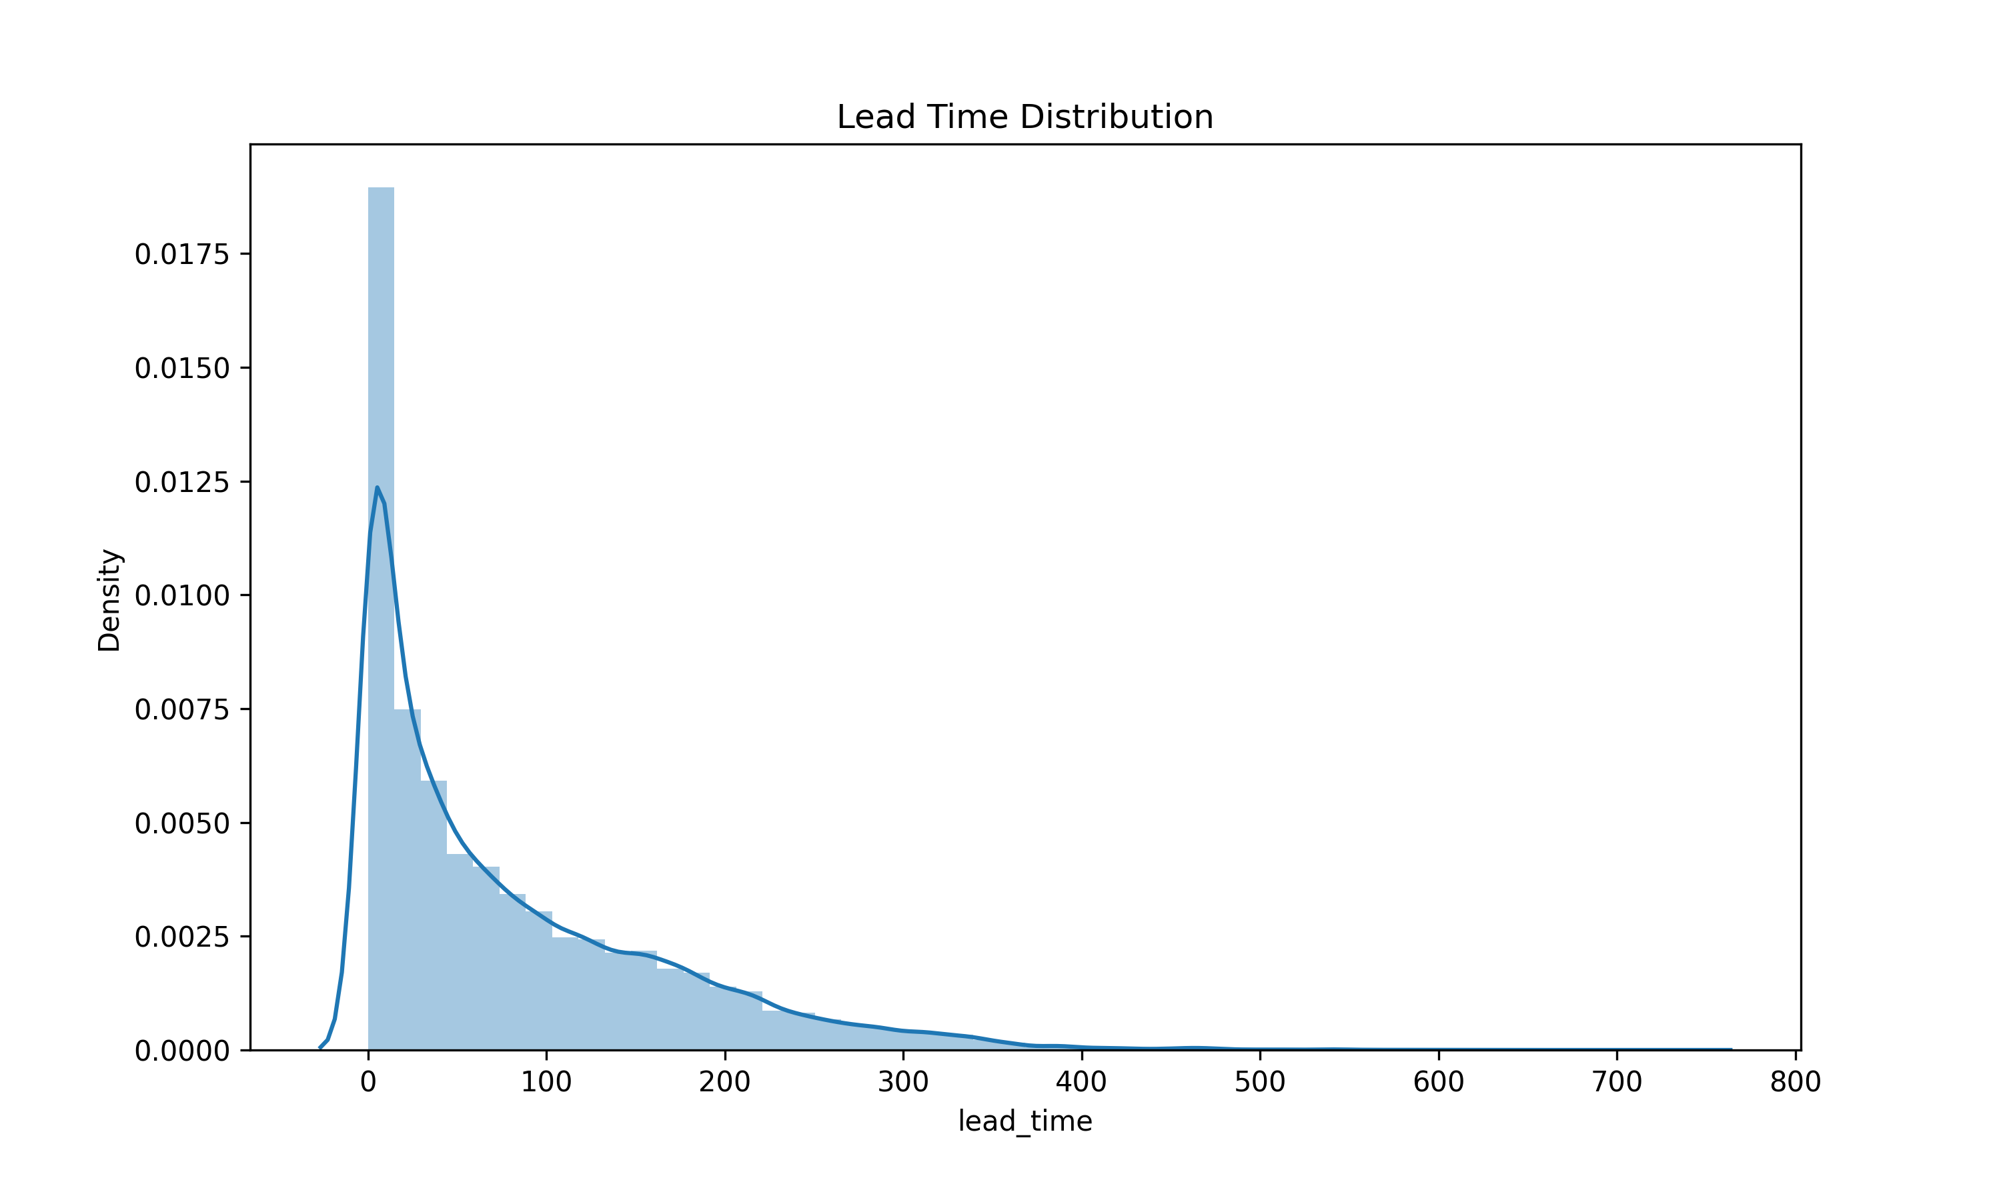
Analysis of Lead Time
Most people book hotels spontaneously, but some people also like to plan their travel in advance

Slide 14
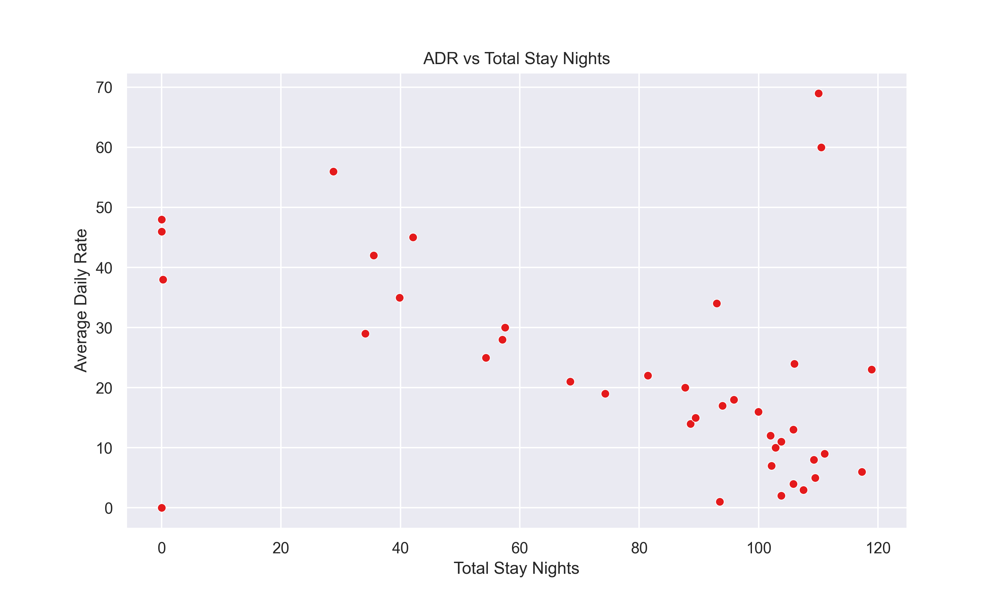
Relationship between Average daily rate and Total Stay
The length of total stay increases as average daily rate decreases. This means for longer stay, the customers can book hotels at a lower price

Slide 15
Solution to Business Objective
Based on the analysis of the hotel booking dataset, here are strategic recommendations for the client to achieve their business objectives: 1. Optimize Revenue Management Dynamic Pricing Strategy: Implement dynamic pricing to adjust room rates based on lead time, seasonal demand, and booking patterns. Offer discounts for advanced bookings to secure reservation and higher rates for last-minute bookings to increase the revenue. Segmented Promotions: Tailor promotional offers based on customer segments identified from country-wise data and booking patterns. Create targeted campaigns for high-value markets. Cancellation Policy Optimization: Revise cancellation policies to reduce the financial impact of cancellations. Offer incentives for non-refundable bookings while providing flexibility for bookings made with short lead times. 2. Enhance Marketing Efforts Seasonal Campaigns: Launch marketing campaigns targeting peak seasons (July and August) and low-demand periods (November to March). Promote special packages and discounts to attract bookings during slower months. Focus on Key Markets: Use insights from the top 10 country-wise data to concentrate marketing efforts on the highest booking sources. Customize marketing messages to resonate with these audiences.

Slide 16
Solution to Business Objective (Contd.)
3. Improve Operational Efficiency Resource Allocation: Plan staffing, and resource management based on booking patterns and lead times. Ensure adequate staffing during peak periods and efficient use of resources during off-peak times. 4. Risk Mitigation Diversify Market Base: Reduce dependency on a few market segments by expanding marketing efforts to attract guests from underrepresented market segments.

Slide 17
Conclusions
1. City hotel is more preferred over Resort hotel by the guests. 2. Around 27.5% of booking gets cancelled. City hotel has a higher cancellation rate than the Resort hotel. 3. Majority of bookings are made in the month of July and August, while the least number of bookings are made in the month of November. 4. The months of January, February and March sees a higher cancellation rate as compared to others. 5. Best time to book a hotel is from November to March as we are getting lower ADR in this period. 6. Around 53% of total guests come in from Portugal and Great Britain. 7. Most guests book spontaneously but few people also tend to book well in advance. 8. Hotels get most of their business from Online Travel Agents as compared to others. 9. People prefer city hotels for shorter stay and resort hotels for longer stay. Preferred stay in city hotel is between 1 to 4 days and 1 to 7 days in resort hotel. 10. City hotels receives more special requests than Resort hotels. Most of the customers don't have special requests. 11. The length of stay increases as average daily rate decreases. This happens probably because of discounts.

Slide 18
Thank You

